Slide 1
Know the Risks of Opioids and Illicit Drugs
Office of Public Health
Bureau of Community Preparedness
November 2024

Slide 2
Objectives
By the end of this presentation, attendees will be able to:
Define opioid use disorder (OUD).
Understand the risks of OUD.
Identify indicators of OUD.
Recognize the signs of an opioid overdose.
Understand how to administer Narcan to save a life.

Slide 3
What are Opioids?
EXAMPLES OF OPIOIDS
Codeine
Fentanyl
Hydrocodone (e.g., Norco)
Hydromorphone
Methadone
Morphine
Oxycodone (e.g., OxyContin, Percocet)
Oxymorphone
Tapentadol
Opioids are a class of drugs that include synthetic opioids such as fentanyl, legally prescribed pain relievers such as oxycodone (OxyContin), hydrocodone (Norco), codeine and morphine, as well as the illegal drug heroin, among others (NIH, 2024).
Prescription opioids are used to treat moderate-to-severe pain and may be prescribed following surgery, injury or for chronic conditions such as cancer.
In 2022, nearly 14% of all drug overdose deaths involved prescription opioids.
From 1999 to 2022, approximately 294,000 people in the U.S. died from an overdose involving prescription opioids.
The number of U.S. drug overdose deaths involving prescription opioids in 2022 was approximately four times the number in 1999.
NIH. Opioids Highlights (2024). https://nida.nih.gov/research-topics/opioids#:~:text=Opioids%20are%20a%20class%20of,drug%20heroin%3B%20and%20many%20others.
CDC. Basics About Prescription Opioids (2024). https://bit.ly/40bf9V7

Slide 4
How Do Opioids Work?
Opioids are a class of drugs commonly prescribed to treat pain.
Opioids attach to opioid receptors in the brain, spinal cord and gastrointestinal tract.
Many opioids produce a strong euphoric effect in the brain.
Opioid drugs create a shortcut to the brain’s reward system, flooding the brain’s “pleasure center” with dopamine.
Prolonged use alters the way nerve receptors function in the brain.
PursueCare. What are Opioids and Opioid Addiction? Published 4 October 2019. Available at https://www.pursuecare.com/what-are-opioids-opioid-addiction.

Slide 5
Opioid Use Disorder
Opioid use disorder (OUD) is a substance use disorder, sometimes referred to as opioid abuse or dependence or opioid addiction. It involves a problematic pattern of opioid use that causes significant impairment or distress. OUD is a treatable, chronic disease that can affect anyone, regardless of race, gender, income level or social class.
Increased Risk:
Anyone who takes prescription opioids can develop opioid use disorder.
Physical dependence may develop over time with continued opioid use.
Ways to Prevent:
Prescription drug monitoring programs
Academic detailing
Quality improvement programs
Patient education
CDC. Preventing Opioid Use Disorder (2024). https://bit.ly/4eHNFe9

Slide 6
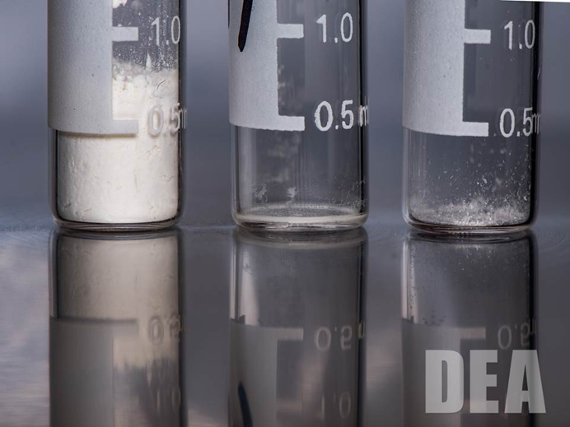
Illegal Opioids: The Dose Makes the Poison
Heroin: 2-5 times stronger than morphine
Fentanyl: 30-50 times stronger than heroin and 50-100 times stronger than morphine
Carfentanil: 100 times stronger than fentanyl and 10,000 times stronger than morphine
https://www.dea.gov/galleries/drug-images/fentanyl

Slide 7
Substance Use Disorder
COMMONLY USED SUBSTANCES
Alcohol
Cannabis
Hallucinogens
Inhalants
Opioids (Prescription and Illegal)
Sedatives, hypnotics or anxiolytics
Stimulants and psychostimulants
Tobacco (nicotine)
Other (unknown) substance
Substance use disorder (SUD) is a treatable, chronic disease marked by a cluster of cognitive, behavioral and physiological symptoms, indicating that an individual continues using a substance despite experiencing significant substance-related problems.
SUDs can lead to major problems across all areas of a person's life.
SUDs vary in severity, from mild to severe, and can affect people of any race, gender, income level or social class.
CDC. Treatment of Substance Use Disorders (April 2024). Available at https://www.cdc.gov/overdose-prevention/treatment/index.html.

Slide 8
Signs of a Substance Use Problem
Increased Cravings and Loss of Control
Reporting lost or stolen medications
Doctor shopping
Seeking opioids from others
Engaging in risky behaviors
Increased usage
Preoccupation with opioid use
Shifting moods
Dismissing professional treatment
Changes in physical appearance
Ignoring Negative Consequences
Over-sedation
Social withdrawal
Strained family relationships
Encountering trouble with the police
Falling into debt
Work-related issues

Slide 9
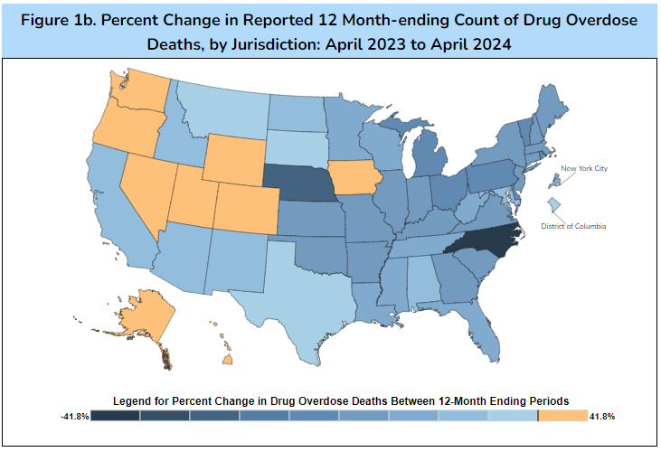
The Opioid Epidemic in the U.S.
12.2% decrease for the United States.
11% decrease for Louisiana for the time period.
CDC. Provisional Drug Overdose Death Counts, 2024. https://bit.ly/3zNfIK0
Notes:
READ SLIDE.
Drug overdose deaths, primarily from prescription medications, is the leading cause of accidental death in the U.S….More than car crash deaths. Clearly misusing prescription medications can be harmful to your health. Also, prescription drugs are among the most misused substance in the US more than illicit “street” drugs.
The most commonly misused prescription drugs include opioid pain medications, sedatives and stimulants.
Drug overdose deaths are identified using ICD–10 underlying cause-of-death codes: X40–X44, X60–X64, X85, and Y10–Y14.
Percent change refers to the relative difference between the reported or predicted provisional numbers of deaths due to drug overdose occurring in the 12-month period ending in the month indicated compared with the 12-month period ending in the same month of the previous year.

Slide 10
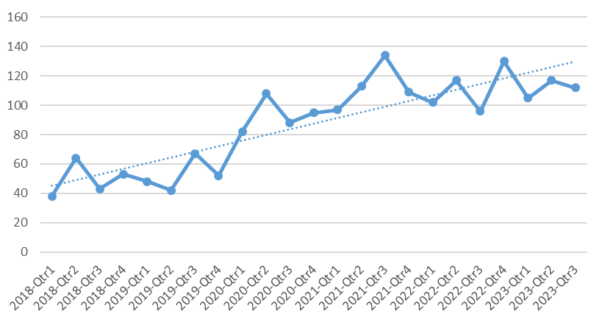
Drug-Involved Deaths by Quarter and Location, 2018-2023*,OPH Region 2 (Capital Area)
*2023 data are preliminary
Notes:
Area 2018-Qtr1 2018-Qtr2 2018-Qtr3 2018-Qtr4 2019-Qtr1 2019-Qtr2 2019-Qtr3 2019-Qtr4 2020-Qtr1 2020-Qtr2 2020-Qtr3 2020-Qtr4 2021-Qtr1 2021-Qtr2 2021-Qtr3
Region 2 - 38 64 43 53 48 42 67 52 82 108 88 95 97 113
2021-Qtr4 2022-Qtr1 2022-Qtr2 2022-Qtr3 2022-Qtr4 2023-Qtr1 2023-Qtr2 2023-Qtr3
134 109 102 117 96 130 105 117 112

Slide 11
Louisiana Opioid Data Dashboard, 2024

Slide 12
Illegal Opioids: The Dose Makes the Poison
Heroin is a highly addictive drug and a rapidly acting opioid.
An opiate (narcotic) drug processed from morphine and extracted from certain poppy plants, heroin appears as a white or brownish powder or a black sticky substance known as black tar heroin.
Heroin is often cut with other drugs or substances, such as sugar or powdered milk. The user may be unaware of the actual amount of heroin they are using, increasing the likelihood of overdose.
www.dea.gov (2004)

Slide 13
Illegal Opioids: The Dose Makes the Poison
Fentanyl is a potent synthetic opioid drug.
It is approved by the Food and Drug Administration (FDA) for use as an analgesic (pain relief) and anesthetic.
It is approximately 100 times more potent than morphine and 50 times more potent than heroin as an analgesic.
www.dea.gov (2004)

Slide 14
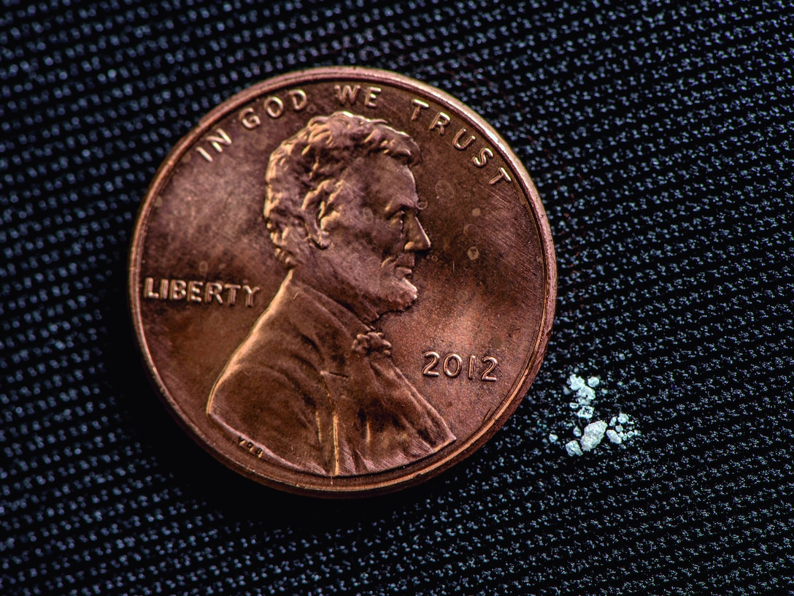
Fentanyl: A Lethal Dose

Slide 15
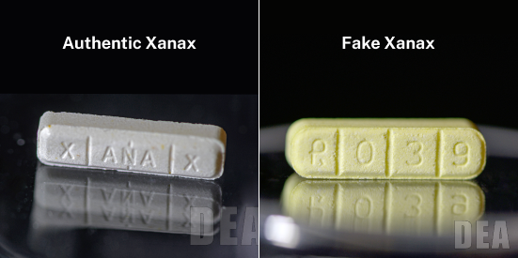
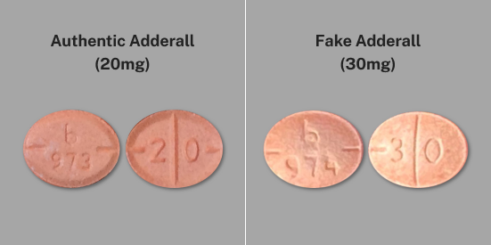
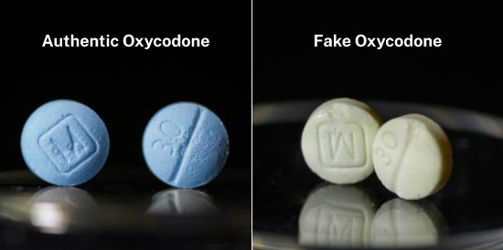
Real or Fake? Can You Tell the Difference?
Never trust your own eyes to determine if a pill is legitimate. The only safe medications are those prescribed by a trusted medical professional and dispensed by a licensed pharmacist.
www.dea.gov (2004)

Slide 16
Emerging Threat of Xylazine in Combination with Fentanyl
Xylazine is a non-opioid central nervous system depressant that can cause drowsiness, amnesia, slowed breathing, reduced heart rate and dangerously low blood pressure.
Xylazine was involved in 39 overdose deaths in 2021, an 86% increase from 2020.
The contribution of xylazine to overdose deaths is likely underreported due to non-specific causes of death used in the death records database, such as “multi-drug toxicity” or “cardiac arrest due to polysubstance abuse.”
If an overdose from a xylazine-containing drug occurs, administer naloxone. This is recommended because xylazine is often combined with fentanyl.
Considering the increasingly dangerous illicit drug supply, the Louisiana Department of Health (LDH) strongly recommends that individuals using drugs, their friends and their families have naloxone readily available.
Louisiana State Board of Medical Examiners. Published 2023 May 11. Available at https://lsbme.la.gov/emerging-threat-of-xylazine-in-combination-with-fentanyl.

Slide 17
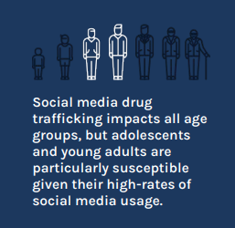
Drug Trafficking through Social Media
www.dea.gov (2004)

Slide 18
How Does Naloxone (Narcan) Work?
Naloxone is a medicine that rapidly reverses an opioid overdose.
It acts as an opioid antagonist.
Naloxone can quickly restore normal breathing in a person whose breathing has slowed or stopped due to an opioid overdose.
It has no effect on individuals without opioids in their system.
Naloxone is not a treatment for opioid use disorder.
Naloxone should be administered to anyone showing signs of an opioid overdose or when an overdose is suspected.
NIDA. 2022, January 11. Naloxone DrugFacts. Retrieved from https://nida.nih.gov/publications/drugfacts/naloxone on 2024 October 19.

Slide 19
Opioids Responsive to Naloxone
Naloxone is a life-saving medication that can reverse an overdose from opioids, including heroin, fentanyl and prescription opioids, if administered in time.
Naloxone is a simple, portable tool that anyone can use, even without medical training. It’s available in two forms: nasal spray and injectable.
PRESCRIPTION OPIOIDS
Hydrocodone (Norco)
Oxycodone (OxyContin, Percocet)
Oxymorphone
Morphine (MS Contin)
Codeine
Fentanyl
ILLICIT OPIOIDS
Synthetic fentanyl and derivatives
Heroin
Nitazenes
CDC. Lifesaving Naloxone, 2024. https://www.cdc.gov/stop-overdose/caring/naloxone.html

Slide 20
What Does an Opioid Overdose Look Like?
Unresponsive to shouting or touch, or not waking up
Breathing that is very slow (fewer than 10 beats per minute), irregular or stopped
Blue, gray or ashy lips and fingernails
Pinpoint pupils
Paraphernalia or items around the person that suggest drug use
Notes:
This is a list of the most common signs of an opioid overdose. A person who is experiencing an overdose may show all of these signs or may just show one or two. If the person fits any of the signs of opioid overdose, it is important to call 911 and give naloxone.

Slide 21
What to Do if Someone Overdoses
Call 911 immediately.
Lay the person on their side to prevent choking.
Administer naloxone, if available.
Try to keep the person awake and breathing.
Try to keep them warm.
Administer a second dose of naloxone if required.
Stay with them until emergency responders arrive.
Notes:
Tap and shout at the person to see if you are able to wake them. If the person is unresponsive and fits other signs of opioid overdose, call 911 and give naloxone.
Especially if you’re alone, it’s best to call 911 before you give naloxone. As soon as you call 911, first responders will be dispatched to your location. After calling 911, you can give naloxone or follow the directions of the 911 dispatcher until help arrives.
Time is of the essence—you only have a few minutes to help someone who has stopped breathing.
It’s important to stay with the person once you’ve called 911. The first responders may need help locating the victim or you may have to give more naloxone if the victim does not appear to be coming out of an overdose. Personal safety is important of course, so if you feel you need to leave the scene for your safety, you should.

Slide 22
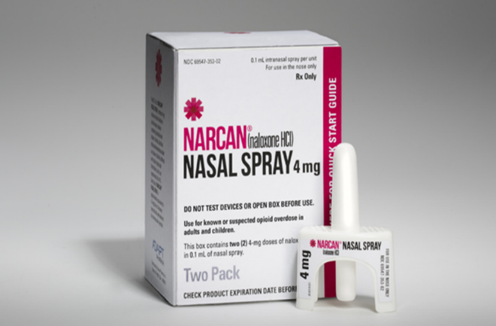
Opioid Overdose: Lifesaving Response
HOW TO SAVE A LIFE VIDEO
https://www.youtube.com/watch?v=WnjgrRNMfKM

Slide 23
Other Substances Related to Adverse Opioid Incidents
Stimulants
Adderall
Ritalin
Cocaine
Methamphetamines
Prescription Depressants
Xanax
Valium
Ambien
Benzodiazepines
Barbiturates

Slide 24
Key Facts About Vaping

Slide 25
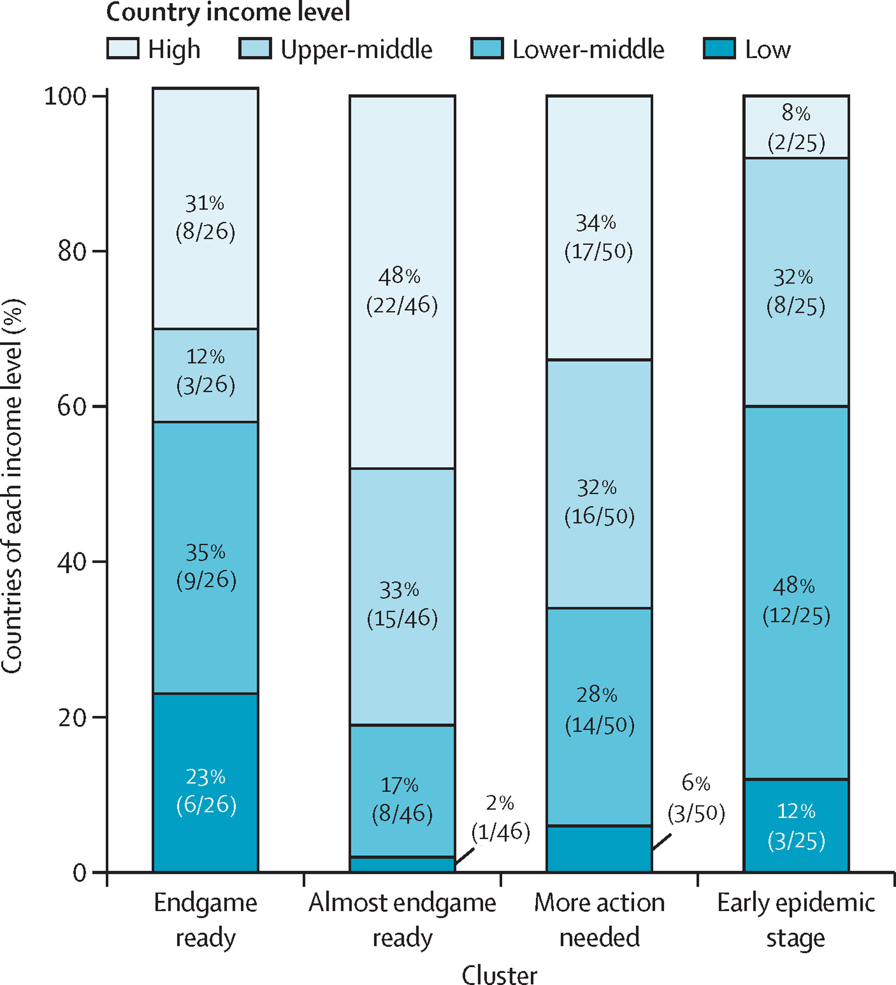
Serious Short- and Long-Term Health Risks Associated with Vaping
A country's readiness to set a tobacco endgame target and sustainably pursue novel endgame measures is influenced by various factors: the strength of existing Framework Convention on Tobacco Control (FCTC) measures, smoking prevalence, political leadership, public support and whether there is a sense of unity in the public health community.
To achieve endgame targets, most countries have opted for a multipronged approach to fill in remaining FCTC implementation gaps with measures such as plain packaging, smoke-free legislation, restricting youth access, advertising bans, taxes, quit support, regulation of e-cigarettes and health warnings on individual cigarettes.
Selvan, et al. Lancet Glob Health 2024;12: e1049–58.

Slide 26
Effects of E-Cigarettes
E-cigarette aerosol is NOT harmless “water vapor.”
It can contain harmful and potentially harmful substances.
Many e-cigarettes contain nicotine salts.
Nicotine salts allow people to consume high levels of nicotine without experiencing the harshness of freebase nicotine.
CDC. About E-Cigarettes (Vapes), 2024. https://www.cdc.gov/tobacco/e-cigarettes/about.html

Slide 27
Harm Reduction Strategies

Slide 28
Harm Reduction Strategies
Harm reduction is a public health approach that focuses on mitigating the harmful consequences of drug use, including infectious disease transmission and overdose, by providing care that is free of stigma and centered on the needs of people who use drugs.
Collaborations between public health and public safety strengthen and improve efforts to reduce drug overdoses.
Linkage to care initiatives utilize nonfatal overdose and other data from different potential data sources — such as emergency medical services, emergency departments/health systems, justice systems and harm reduction services — to identify people who are at risk for overdose or have recently experienced a nonfatal overdose and link them with evidence-based treatment options, services and supports.
CDC. Overdose Data to Action: Prevention Strategies (2024). https://bit.ly/407pHEt

Slide 29
Fentanyl Test Strips: A Harm Reduction Strategy
Fentanyl test strips (FTS) are a low-cost harm reduction tool that can be used to prevent overdoses when combined with other strategies.
FTS provide people who use drugs and communities with important information about fentanyl in the illegal drug supply, enabling them to take steps to reduce the risk of overdose.
In April 2021, the CDC and the Substance Abuse and Mental Health Services Administration (SAMHSA) announced that federal funding could be used to purchase FTS.
Allowing federal grant programs to purchase FTS helps create opportunities for people who use drugs to interact with community-based organizations that may also offer mental health and behavioral services they need.
CDC. What You Can Do to Test for Fentanyl (2024). https://bit.ly/3zQvUdv

Slide 30
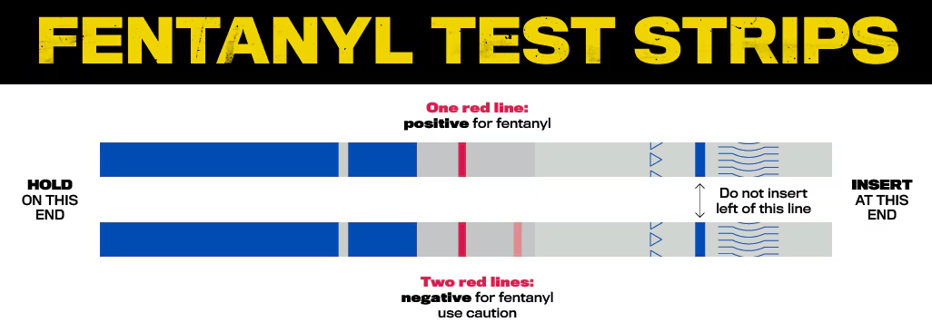
Fentanyl Test Strips: A Harm Reduction Strategy
How to use them:
Put a small amount (at least 10 mg) of your drugs aside in a clean, dry container.
Add water to the container and mix together. For most drugs, you need ½ teaspoon of water. If you are testing methamphetamines, MDMA or ecstasy, use 1 full teaspoon for every 10 mg of crystal or powder you are testing.
Place the wavy end of the test strip down in the water and let it absorb for about 15 seconds.
Remove the strip out of the water and place it on a flat surface for 2 to 5 minutes.
Read results.
CDC. What You Can Do to Test for Fentanyl (2024). https://bit.ly/3zQvUdv

Slide 31
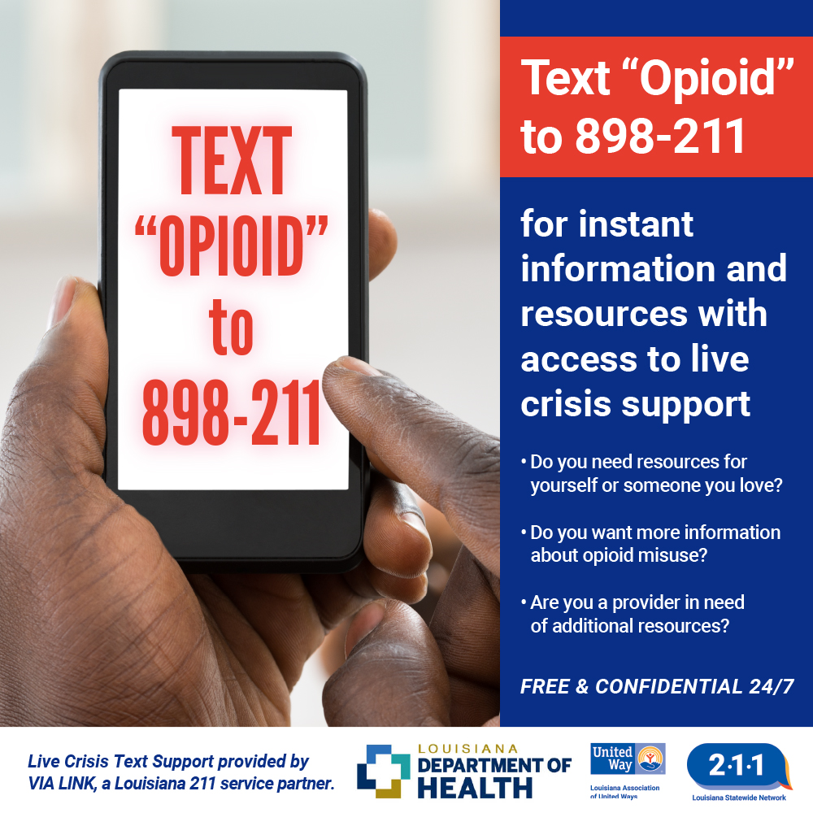
Resources
Call or text 988 or visit Louisiana988.org for free, confidential emotional support, available 24/7
OpioidHelpLA.org
TreatmentAtlas.org

Slide 32
Trudy Wickham
Region 2 Overdose Prevention Coordinator
Trudy.wickham@la.gov
225-772-5321
Office of Public Health/Bureau of Community Preparedness
www.ldh.la.gov

