Slide 1
Youth Resources for Adult Services 2025

Slide 2
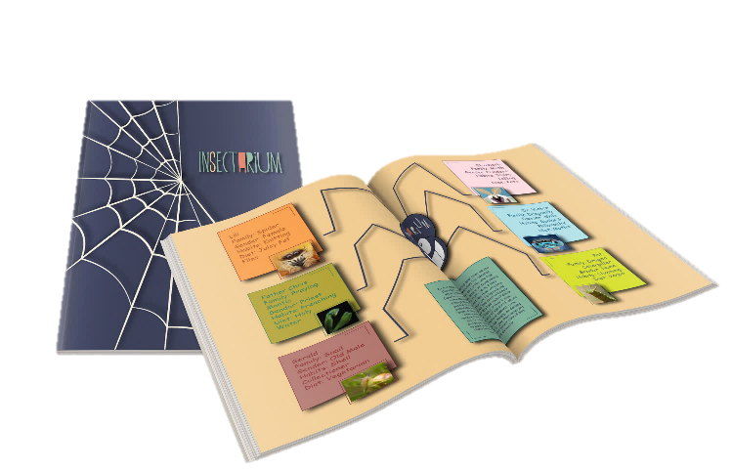
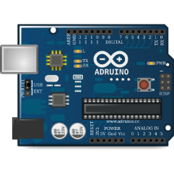
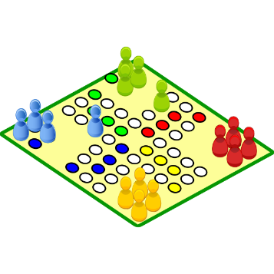
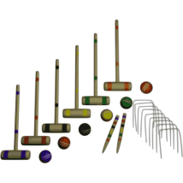
Library Collection & Resources
Playaways
Launchpads
Wonderbooks
Board Games and Family Kits
AWEs, iPads, Game Tables

Slide 3
Sensory Sensitivity
Sensory Sensitive Time in Children’s, all branches, 1 x per month
Noise Canceling Headphones (available at each branch, all depts at Main)
Sunglasses (available in all Children’s Rooms, all depts at Main)
Various Fidgets (available in all Children’s Rooms, all depts at Main)
Sensory Booklets for patrons to preview each branch before visiting (these will be finished soon!!!)

Slide 4
Library Card Categories (0 to 17)
Standard Card
Restricted “Bookshelf” Card
Unrestricted “Explore” Card
Computer Use Only Card – rarely used

Slide 5
Children's Programming Materials
YOU TOO can borrow the Children's Programming Kits!!!
WHY you ask???
Adult programming – but your patrons have brought their children
Adult programming – but you'd like to INCLUDE the whole family
Collaborative programming at your branch
WHAT type of programming kits are available?

Slide 6
Children's Programming Materials
From the Children's HUB Homepage: Quick Button – Requests from Main
SEVEN PDF files
Shared tools and Programming items (2 separate files)
Kid Games
Programming Kits
Movies (approved for in-house usage)
Puzzles
STEM materials

Slide 7
Kids’ Page
Books & Reading – eBooks, eAudio, and reading databases
Homework & Learning – Homework and Homeschool help
Interactive & Fun – Fun videos, activities, and online games
Kids Databases A-Z – Various research and educational databases
Monthly Calendars – Monthly branch calendars and storytime flyer
Parent Portal – From parenting resources to literacy programs

Slide 8
Parent Portal
Parent specific databases that provide information regarding various topics of interest to parents
Includes resources for working with neuro-diverse and learning-disabled students
Includes toy guide
Includes family and health education

Slide 9
Digital Resources
FREE TUTORING!!
Online, live chat for tutoring in any subject
24/7 Resources for test prep
Open 10 am -12 am, 7 days a week in English and Spanish
Tutoring in Vietnamese is also available
Tutors are actual teachers - Vetted by the Tutor.com company
Princeton Review ACT/SAT essentials
Essay and Resume drop-off
Math drop-off
Audio capabilities
Help for college students and adults, too!
Notes:
Tutors available in Vietnamese 6 PM – 9 PM Every day
Tutors available in Spanish 10 AM – Midnight Sunday - Saturday
Just in case people ask
Students can ask for the same tutor every time if they find one especially helpful.
All of the tutors have degrees in the subject they are tutoring or in education of the subject they are tutoring.
All of the tutors must pass an exam given by Tutor.com. Only 7% pass the exam. Of that 7%, they are further weeded out by training to make sure they can tutor in the online environment.
All of the tutors have their backgrounds checked every three months, so there is no reason to worry that an inappropriate relationship will develop.
24/7 Resources
Resources for AP, ACT, SAT, ASVAB, and other standardized tests, which they can take and get the results to go over alone, or they can review them with a tutor.
Students can drop off essays or resumes to be corrected/improved, which they will get back in about 12 hours;
Students can also drop off a math question to get help; those are returned in about 24 hours.
Students can watch videos for AP prep for Biology, Calculus, United States History, and World History.
SkillsCenter Utilize study resources including flashcards, learning games, worksheets, quizzes and more.

Slide 10
Children’s Digital Resources Going Away
ABDO Zoom (when expires)
World Almanac Kids & World Almanac Kids Elementary (when expires)
World Book Apps (As of 6/30/25)
Activity Corner​
Dramatic Learning​
Enciclopedia Estudiantil Hallazgos​
L'Encylopédie Découverte​
World Book Wizard​​

Slide 11
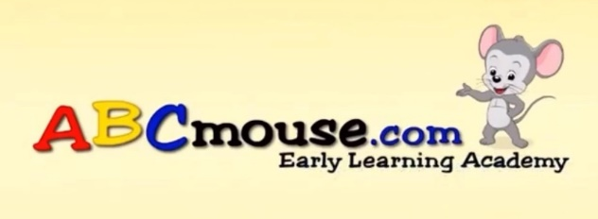
Children’s Digital Resources
Guided learning in several different subjects including math, science, and social studies and early learning for preschool ages
For toddlers through second grade
Includes puzzles and games
Children earn tickets for completing activities to spend in the online shop for avatar accessories, online pets, and more
Notes:
Activity Corner World Book
General craft & activity database searchable by ages, type of activity, culture, time to complete, cost of materials, type of materials, holiday themes, and keyword

Slide 12
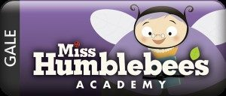
Children’s Digital Resources
Contains videos on 14 different broad topics, broken down into various sub-topics
Games: True or false, matching, tracing letters, concentration (matching cards)
Stories grouped by 18 different topics, both read aloud and read along features
Activities: Coloring, paint by number, print and do mazes, connect the dots, and more
Guided learning in several different subjects most of which include printables for the lessons: social emotional learning, art and music, library (stories), math, science, social studies
Includes audio instructions and audio while hovering
Books have read aloud and read along features
Notes:
Miss Humblebee’s Academy
Guided learning in several different subjects most of which include printables for the lessons
Social emotional learning
Art and music
Library (stories that can be read to them, or that they can read to themselves)
Math, Science, Social studies
Includes audio instructions and audio while hovering
Book have read aloud and read along features

Slide 13
Children’s Digital Resources
Streaming video
Video field trips
Educational and entertaining videos including many popular book and TV characters
Transcript to videos are provided with automatic read along
Short videos teaching children about 9 broad topics
Worksheets provided for readers and for non-readers
“Key Words” are included for child to learn from the video, includes read aloud for key words
A short “Quiz Whiz” for each video included

Slide 14
Children’s Digital Resources
For K through 2nd grade
Research database with easier vocabulary and simpler explanations
Includes videos, citations, and activities
For grades 3 through 6
Research database with more information and sophisticated content
Includes citations, activities, and more
Notes:
Pebble Go -- Grades K-2
Research database for kids, broken down into simple, broad subjects
Spanish is available; Includes audio upon hovering for topic choices
Read aloud as well as read along features
Pebble Go Next
Pebble Go Next—grades 3-6
Research database for kids, broken down into simple, broad subjects
Spanish is available
Read aloud as well as read along features

Slide 15
Children’s Digital Resources
Fiction Picture book video paired with Non-fiction eBook
For Pre-K through 2nd grade
eBook and video biographies and histories covering multiple topics
Includes additional activities and recommended reading
Science projects
Includes step-by-step info to assist students
Science careers
Science research database
Science news
Notes:
Bookflix, ScienceFlix, and TrueFlix
Bookflix pairs a nonfiction book with fiction book (also has Spanish)
Includes audio upon hovering for topic choices
Read aloud and read along features and slower reading speed option
Scienceflix can be browsed by topic, experiments, science careers, and news, or you can use a keyword search.
Read aloud and read along features and read aloud navigation feature
Trueflix—biography and history
Read aloud and read along features and slower reading speed option

Slide 16
Children’s Digital Resources
Online research database
Good for grades K-5 with 2 levels of reading
Can search by topic or through eBooks, news articles, and magazines
Provides citations for reports in multiple formats
Read aloud feature for non-readers and struggling readers
Notes:
Gale In Context Elementary
Curated research information for elementary ages searchable by 11 broad subjects or by search terms. Each topic contains extended reading, quick facts, and additional information broken down by eBook, eMags, news and more

Slide 17
Children’s Digital Resources
Online research database
Good for grades K-5
Includes pictures, videos, activities, and more
Provides citations for reports in multiple formats
Read aloud feature for non-readers and struggling readers
Notes:
World Book Kids
Research database
Educator resources including, lesson plans, webquest, and curriculum correlations
Search or browse by topic or search by keyword
Contains videos and photographs, science projects, activities, and games
Google translate to provide access in many languages
Read aloud and read along features

Slide 18
Children’s Digital Resources
Every eBook that World Book has published
Nonfiction and classics
Searchable by keyword or topic
eBooks, AudioBooks, and Read-a-Longs
Includes books on STEM, graphic novels, videos and more!
Notes:
World eBook
Every eBook that World Book has published
Nonfiction and classics, searchable by keyword or topic
Tumblebooks: eBooks for Kids
Some are read along (highlights words as they go), some are read to me (just reads it aloud)
Some French and Spanish
No wait list (like Overdrive/Libby), and no limit to usage

Slide 19
Children’s Digital Resources
eBooks on math topics
Counting
Addition, subtraction
Multiplication, division
Word problems
And more!
Kids interface
eBooks, audiobooks, and Read-a-Longs
Includes graphic novels, easy readers, and pictures books
Notes:
Tumble Math
Digital collection of eBooks covering 14 math topics in story book format
Overdrive/Libby
Various features available depending upon the devise used and the books chosen
Read aloud and read along
Dyslexic and other various fonts
Font and display manipulative features such as size, margins, line spacing, and background/font colors

Slide 20
Children’s Digital Resources
From the creators of ABC Mouse
Online Role Playing Game that teaches Math, ELA, Science, Social Studies, and more
For ages 8-13
Requires patron to create a login and password

Slide 21
Children’s Digital Resources
Valuable resource tool for parents and educators
PDF printable lesson plans and worksheets
Specified units searchable by topic and grade level
From early learning ages through 8th Grade
Notes:
Scholastic Teachables
Valuable tool for parents and educators
PDF printable lesson plans and worksheets on specified units searchable by topic and grade level

Slide 22
Children’s Digital Resources
Previously Mailbox Magazine now in Digital
New content every month
Printable activities, Lesson Plans, and More
Content separated by age groups
Pre-Kindergarten
Kindergarten
Grade 1
Grade 2-3
Grade 4-6

Slide 23
Teen Page
Information on Programs Around the Parish
Links to Digital Resources
Driving Exam Practice
Links to Infoguides
Great Reads for Teens
Just for Teens: Gaming, Crafts, Music
New Books for Teens
LYRC/LTRC Book Lists
Virtual Volunteering Opportunity
www.ebrpl.com/departments/teens

Slide 24
Digital Resources
Novelist K-8 Plus
Readers’ Advisory Database/Tool
Books separated by Teen, 9-12 years, and 0-8 years
Includes title read-a-likes, author read-a-likes, series read-a-likes
Includes professional reviews
And more!
Novelist Plus
Readers’ Advisory Database/Tool
Books also separated by Adult
Includes title read-a-likes, author read-a-likes, series read-a-likes
Includes professional reviews
And more!

Slide 25
Digital Resources
CultureGrams Kids Edition
General reference database
searchable by keyword or by country
includes information on people and places, history, lifestyle, society, culture facts, quick facts, and more
CultureGrams World Edition
General reference database
searchable by keyword or by country
Includes same information but in more detail for older students and adults
Also available: States Edition & Canadian Provinces Edition
Notes:
You can listen to the articles.

Slide 26
Digital Resources
School Center – Elementary, Middle, and High School
Practice tests, eBooks, & tutorials
Math, Social Studies, English Language Arts, Science
College Prep Center
Practice tests, eBooks, & tutorials
ACT, SAT, PSAT/NMSQT, AP Exams, TOEFL iBT, and IELTS Tests
Student Success Skills
How to Memorize; How to Read Strategically; Multitasking Strategies; Reach Your Goals; Stay Organized; Test Taking Strategies; Use Your Time Wisely
Information Literacy Skills
What is Information Literacy?; How to Avoid Plagiarism; How to Find Good Sources; Succeed in Your Academic Writing
Notes:
School Center
Divides the subjects up into particular sections, e.g. Math has Algebra, Functions, Geometry, etc.
Elementary only has Math and English Language Arts
Middle School has Math, English Language Arts, Social Studies, and High School Entrance Exams Prep
High School has Math, English Language Arts, Science, Social Studies, Technology, and Logic and Reasoning.
Computer Skills Center
Video courses to learn popular software and computer basics.
High School Equivalency Center
Preparation for the GED, HiSET, or TASC Tests
Life Skills
Student Success Skills>Skills for Success in High School>Life Skills
Healthy Habits
How to Manage Your Money
The Basics of Credit
The Basics of Debt
Job and Career Accelerator
Learn more about a career
Prepare for an occupation exam
Job search and workplace skills
Great Resumes
You have to search “great resumes” before you click on a specific “center.”
There is a tutorial to walk the patron through a resume.

Slide 27
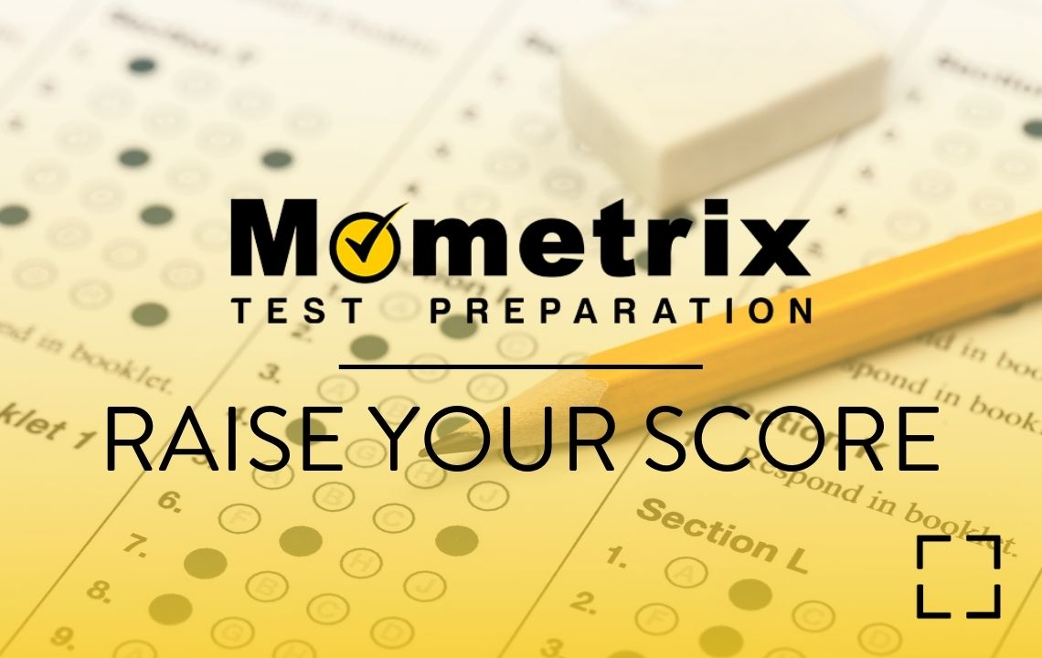
Digital Resources
Test prep for grades K through college
Study Guides
Test taking/Test anxiety tips
Practice tests
Flashcards
Differentiated learning
Quick study sessions
Building knowledge one concept at a time
Videos to help review concepts
Practice question books
Additional practice questions
Exam simulation with very thorough answers to help student learn the concepts
Employment Resources
Update Resume
Help for students to apply for college, scholarships, and financial aid

Slide 28
Digital Resources
Uses sources from EBSCO and Gale
Browse Topics
Encyclopedia Articles
Journal Articles
Uses sources from EBSCO
Browse Topics
Books
Encyclopedia Articles
Journal Articles
Notes:
Credo
Mind maps on some subjects to help narrow ideas for preparing for an essay
Lists of key concepts under each article entry
Real-time reference (in order of “real-time importance”)
Titles give you eBooks about the subject
Images are charts and graphs and pictures that have something to do with the topic
Citations available for each article in APA, Chicago, Harvard, MLA
Explora High School
Topic overview
Narrow down by source, e.g. books, journal articles, primary source documents, etc.
Images that are found within the documents can be opened and cited separately.

Slide 29
Digital Resources
Notes:
Opposing Viewpoints and Biography in Context are now “Gale In Context: Opposing Viewpoints” and “Gale In Context: Biography”
Gale In Context: Opposing Viewpoints:
Sources on both sides of a topic including
Magazine articles and journal articles
Newspaper articles
Videos
Statistics
Audio sources
Reference books
Credible websites
Students can browse topics
Students can browse by item type, e.g. reference book or video, etc.
Gale In Context: Biography:
The most up-to-date information on people
Magazine articles and journal articles
Newspaper articles
Videos
Statistics
Audio sources
Reference books
Credible websites
Students can browse person
Students can browse by occupation, ethnicity, nationality, place of birth, or place of death
Students can browse by item type, e.g. reference book or video, etc.

Slide 30
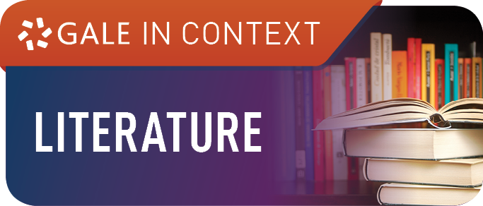
Digital Resources
Notes:
Gale eBooks (Formerly be Gale Virtual Reference Library)
Reference books, many of which we actually have on our shelves.
“For Students” series including, Novels for Students, Drama for Students, Poetry for Students, etc.
Many of the books published by Britannica, DK, Idiot’s Guide series, ABDO Publishing, etc.
Gale Literary Sources
Searches all Gale Literature databases including what was formerly Gale Literary Resource Center, Litfinder, Artemis, etc.
Gale Courses
Science and Math Prep Courses
Writing and Publishing (including Grammar)
Languages (Sign Language, Spanish, French, Italian, Japanese)
Technology
Tools for Teachers: Teaching Students with Learning Disabilities; Empowering Students with Disabilities; Teaching Students with ADHD; Teaching Students with Autism; Handling Medical Emergencies;

Slide 31
Digital Resources
Essay Topics
Literary Classics (Full Text)
Will read text aloud
Poems and Stories (Full Text)
Author files by Publisher’s Weekly
Curriculum Tools: Citing Sources, Evaluating Online Sources, What is Plagiarism? Writing a Research Paper
Videos of dramatic productions, documentary films, lectures and interviews, educational videos

Slide 32
Digital Resources
Poetry – Full Text
Listening Room
Commentaries
History and Criticism of Poems and Poets
Biographies

Slide 33
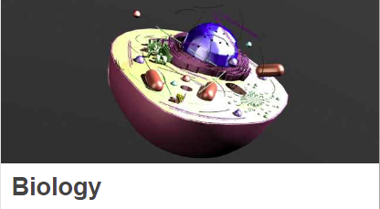
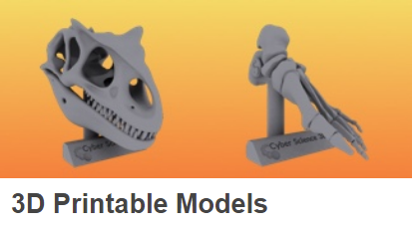
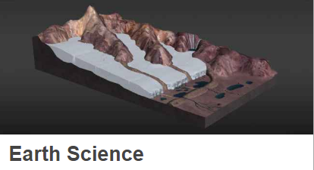
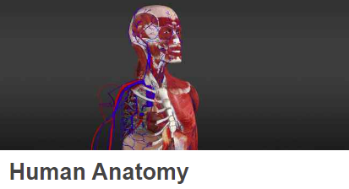
Digital Resources
Notes:
Article explaining about the 3d image on the right-hand side of the page. Has definitions of difficult words in the text, and has a bibliography of the information used in the article.

Slide 34
Digital Resources
Language Learning
Time Management
Yoga, Drawing, Photography, Guitar
Algebra, Grammar, and other supplementary courses
ADHD Focusing & Motivation
Computer Coding
How to Build Self-Discipline
Problem Solving
Drawing
Improve Your Handwriting
Web Development
Notes:
There are plenty of courses that can be applicable to middle and high school, especially in the Personal Development section. Arts and Creativity, Entrepreneurship, Health & Fitness, Life Skills, Personal Growth; and all of these general headings have a lot of courses each.
ADHD Focusing & Motivation Strategies . . . That Actually Work
Dyslexia 101: Definition, Characteristics, Assessment

Slide 35
Digital Resources
School Skills
Math Skills
Learning Study Skills
Information Literacy
Writing a Research Paper
Learning Speed Reading
College Prep: Writing a Strong Essay
Technology Training
3d Animation
Architecture
AutoCAD
Web development
Drawing
Design
Notes:
Linked in LEARNING
Training videos on subjects like study skills, improving your memory, speed reading, 3d animation, architecture, CAD, drawing, design, web development, starting a business, IT, and many more.
Students can make “playlists” of the videos/courses they want to watch
Of immediate concern for students:
Autism Traits: Part 1
Learning and Neurodiversity
ADHD, autism, and dyslexia
Understanding Dyslexia
Communicate Your Needs to a Dyslexic Thinking
Neurodiversity
The Science of Compelling Body Language
Grammar Foundations, Advanced Grammar, Grammar Girl Resources, Check Mechanics: Spelling and Grammar
Algebra, Geometry, Calculus
College Prep: Writing a Strong Essay
Information Literacy
Internet Safety for Students
Time Management Fundamentals
Learning Study Skills
Learning Speed Reading
Writing a Research Paper
Success Habits

Slide 36
Digital Resources - Coding
A learn-to-code software program for ages 8-18 that teaches the skills necessary to make websites, apps, programs, animations and video games
JavaScript, and HTML as you solve puzzles and learn to make your own coding games and websites, for ages 8 to adult

Slide 37
Digital Resources
Building Apps
Coding
Web design
Wordpress
Data analysis
Digital literacy
Algorithms: Sorting and Searching, and many more
Notes:
Treehouse—
Must submit a form for approval to Computer Services before you can use. Approval generally takes 1-2 weeks
Offers video lessons, coding challenges, and comprehensive quizzes for 8 programming languages, HTML, CSS, and several APIs (Application Program Interface)
Also offers classes in web design, data science, cybersecurity, and computer science
Robust courses in iOS and Android development
Able to go at your own pace and get feedback from the community
Spaces are provided to work with code without being able to break anything

Slide 38
Digital Resources
eBooks
Graphic Novels
Enhanced eBooks
Reads the book aloud, and you can follow along
AP English books
Audiobooks
Streaming Video
National Geographic
Subjects: History, Science, Geography, Civics
Notes:
Teen BookCloud
Novels
Enhanced books
AP English books
Audiobooks
Streaming Video
National Geographic: History, Science, Geography, Civics

Slide 39
Digital Resources
eBooks
Graphic Novels
Spanish Language
Audiobooks
Including the Great Courses
Magazines
Notes:
Overdrive
Fiction and Nonfiction
Books check out for three weeks
Return on their own
You may have to be placed on hold for certain books
You can browse by subject (genre), collection (e.g. Teens), format (audio or eBook), and available now
Books on ACT and other types of test prep
You can browse by AR Book Level or Interest Level

Slide 40
Digital Resources
Volleyball
Soccer
Dance
Fitness
Basketball
Self-Defense
Field Hockey
Tennis
Yoga
Pickleball
Lacrosse
Mindfulness
Aquatics
Reading Hive
Gymnastics
Strength and Conditioning
Notes:
Videos on each topic broken down into separate lessons, ex:
Pickleball
Warm-ups
Workouts
Forehand
Backhand
Serves
Shots
Mindfulness
Breathing
Movement
Nature
Yoga
Warmups
Stretching and Restorative Poses
Balancing Poses
Strengthening Poses
Core and Back Bend Poses
Full Sequences

Slide 41
Digital Resources
Notes:
Both have classes to learn various crafts/hobbies, etc.
For Craftsy, you check out a pass to use it for a week.
For Creativebug, you pick a class and do as much of it as you want whenever you want.

Slide 42
Additional Digital Resources
Notes:
Statista
provides access to statistics, forecasts, and studies, especially about businesses and countries
Career Cruising
searches careers and explains many facets of careers, including education, salary, core tasks, as well as attributes and abilities needed for the job
Newsbank
provides access to many newspapers around the country, but features Louisiana newspapers (does have audio component)
Comics Plus for Teens
Comics for teens

Slide 43
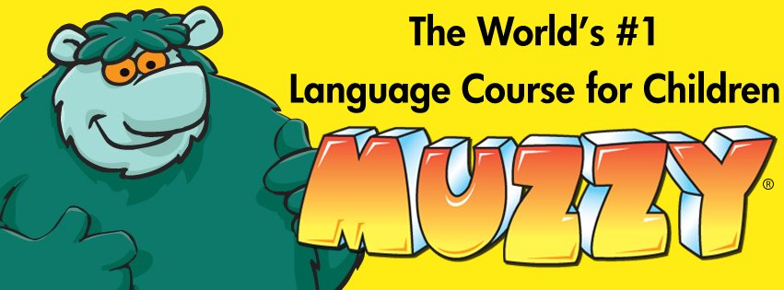
Language Learning
Notes:
Muzzy
8 languages, plus ESL
Free Flow or Guided Courses
Story format to keep kids interested
Videos, Games, and Reviews
Lote 4 Kids
Bilingual eBooks
Picture books from over 60 languages including Sign Language,
All bilingual with English
Mango
72 Languages (including Pirate)
Stream foreign films
ESL/ELL
Has an app for iPhone and Android
Can practice anywhere
There is one way through, and it is straight through
Pronunciation feedback
There are reading and listening comprehension quizzes
They have “specialty courses” which differ depending on the language, e.g. “Spanish for Librarians” in the Latin American Spanish course, or “Wine and Cheese” in the French course.
You can change the translation in the native language from “understood” to “literal.”
Pronunciator
Over 100 Languages
Drills, quizzes, audio lessons, movies, music, etc.
Has an app for iPhone and Android
Can practice anywhere
World Book L’Encyclopédie Découverte
French encyclopedia for beginning French speakers
World Book Enciclopedia Estudiantil Hallazgos
Spanish encyclopedia for beginning Spanish speakers
Gale Udemy
Video Courses to learn Spanish, French, German, Latin, Japanese, Dutch, Hindi, Korean, etc.
Courses on
How to memorize the vocabulary of any language
IELTS (International English Language Testing System) Prep Course etc.
Gale Courses
Courses in Spanish, French, Japanese, Italian, American Sign Language, and more.

Slide 44
Contact Us
If you have any questions about or need help with any of the library’s education resources, please contact:
or visit our website at: www.ebrpl.com
Main Children’s Services: (225) 231-3760
Tara Dearing – tdearing@ebrpl.com
Main Teen Services: (225) 231-3770
Brandi Burton – bburton@ebrpl.com

