Slide 1
Have I Got News for You

Slide 2
Notes:
ChatGPT did a terrible job with this! But it took 2 seconds.

Slide 4
Common Types of Misinformation
False Context
Fabricated Content
Stolen Satire
Imposter Content
Manipulated Content

Slide 5
The SIFT method is an evaluation strategy developed by digital literacy expert, Mike Caulfield, to help determine whether online content can be trusted for credible or reliable sources of information.
Notes:
https://guides.lib.uchicago.edu/misinformation

Slide 6
The CRAAP Test is an evaluation method that was designed by librarian Sarah Blakeslee at the Meriam Library California State University, Chico.

Slide 7
Spotting Fake News
Check the Source
Is the website reputable? (e.g., established news organizations)
Look for an “About” page to verify credibility.
Be wary of sources with a history of spreading misinformation.
Examine the Headline
Does it use sensational or emotionally charged language?
If it sounds too outrageous or unbelievable, verify with other sources.
Verify the Author
Is the author a credible journalist or expert?
Check their background and previous work.
Notes:
Clickbait,
We want to be the first to share something, so tendency to rush

Slide 8
Cross-Check the Information
Are other reliable news sources reporting the same story?
If only one source is covering it, be skeptical.
Look for Supporting Evidence
Does the article cite credible sources?
Be cautious if it lacks references or cites questionable sources.
Watch for Bias
Does the article present only one side of an issue?
Be mindful of confirmation bias—does it simply reinforce your beliefs?

Slide 9
Inspect the Date
Old news can be misrepresented as current events.
Ensure the context is still relevant.
Check the URL
Fake news sites may use URLs that mimic real news sites (e.g., “.co” instead of “.com”).
Assess the Media (Images & Videos)
Reverse search images to see if they’ve been used out of context.
Watch for digitally altered visuals.
Fact-Check
Use fact-checking websites like Snopes, FactCheck.org, or PolitiFact.
If in doubt, wait before sharing.

Slide 10
From
newslit.org

Slide 11
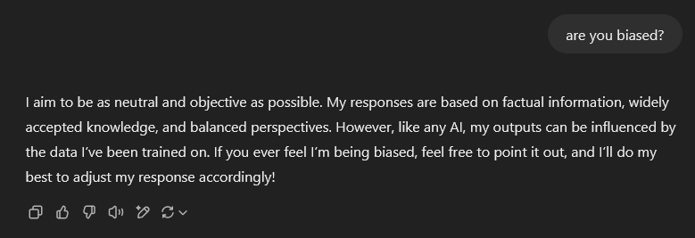
AI Chat Limitations
AI Makes Mistakes
It Only Knows What it’s Been Trained On
Bias
You Get Out What You Put in & Context
Over Reliance
Price
Notes:
Results can be wrong and pull fake articles as fact.
Poor search terms can result in poor answers. Think about the problems that patrons have with asking us questions, what they ask vs what they really mean.
cannot replace the expertise and critical thinking of librarians, it can serve to greatly complement their work.
https://hdsr.mitpress.mit.edu/pub/qh3dbdm9#n8c9ud4ts72 In other scenarios, there is significant bias. When we asked GPT-4 to suggest five books for a 14-year-old boy, it responded with The Hobbit by J.R.R. Tolkien, Harry Potter by J. K. Rowling, Percy Jackson & The Olympians: The Lightning Thief by Rick Riordan, Eragon by Christopher Paolini, and The Maze Runner by James Dashner. In contrast, when we asked GPT-4 to suggest five books for a 14-year-old girl, the results were notably different and highly gendered: Anne of Green Gables by L. M. Montgomery, The Hunger Games by Suzanne Collins, Ella Enchanted by Gail Carson Levine, I Am Malala: How One Girl Stood Up for Education and Changed the World by Malala Yousafzai, and The House with Chicken Legs by Sophie Anderson. Book suggestions distinguish male and female readers according to common stereotypes.
Price, the more you pay the better the information and models you have access to: $0, $20, $200

Slide 12
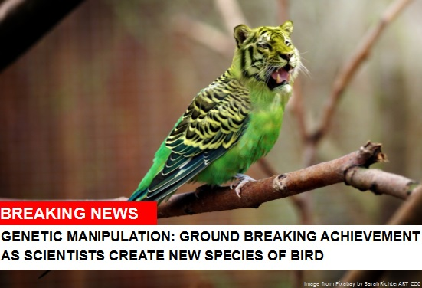
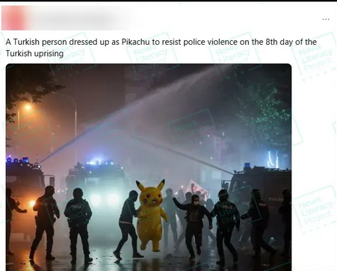
Images & Videos
Look at the Hands
Look at Facial Features
Look at the Details
Look at Text in the Picture
Reverse Image Search
Verify the Source
Notes:
Hands are tricky
Weird facial expressions, eye too big
Details-shadows-reflections-physical laws
AI has a hard time with text
Too smooth-filter or fake. Whole other issue
Deepfake-video, words and mouth might not sync always
In the future we won’t be able to tell
Websites like contentcredentials.org
Look at context, misleading editing.
https://blogs.ncl.ac.uk/subject-support/category/fake-news/
Misuse of celebrities,
Tom Cruise pushing our millage?

Slide 13
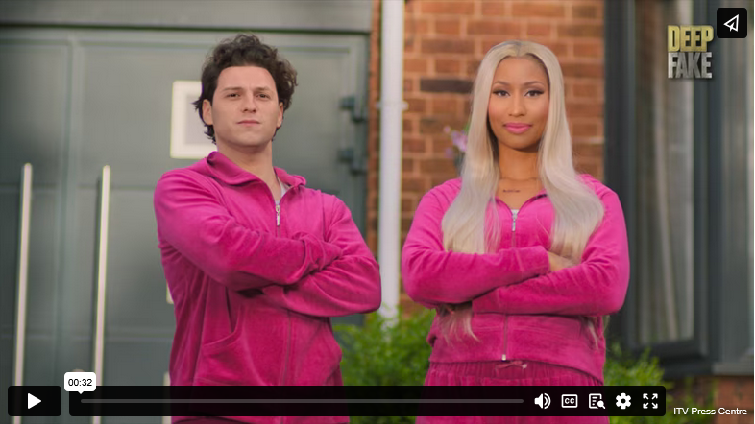
Deepfake
Notes:
King of UK talkshows, died in 2023 now he’s back talking to real celebrities.
Whole other world of questions about using deceased people, actors musicians.
Star Wars using dead actors
Will we finally see Vin Diesel and Elvis Pressley in a movie together?
Deep Fake Neighbour Wars Floyd Mayweather and Dua Lipa are feuding with Matthew McConaughey over his big tree. Meanwhile newlyweds Nicki Minaj and Tom Holland argue with Mark Zuckerberg about a leak.

Slide 14
Knock Off Books
AI Books
Copies
Misleading Titles and Authors
Biographies
Cookbooks
(short, independent, looks at reviews)

Slide 16
The Rhythm of the Algorithm
Social media algorithms are designed to promote user engagement to boost advertising revenue.
This amplification often promotes misinformation and polarization as it doesn’t discern the accuracy of the information.
Filter bubble or personalization?
Real Life vs Social Media: Influencers, keyboard warriors, the troll toll.
Notes:
https://neurosciencenews.com/social-media-behavior-misinformation-23752/
Go incognito
Like everything
Turn off curated feed
Don’t click on links
This means algorithms amplify the very information humans are biased to learn from, and they can oversaturate social media feeds with what the researchers call Prestigious, Ingroup, Moral, and Emotional (PRIME) information, regardless of the content’s accuracy or representativeness of a group’s opinions.
As a result, extreme political content or controversial topics are more likely to be amplified, and if users are not exposed to outside opinions, they might find themselves with a false understanding of the majority opinion of different groups.
Anti-immigration feed, click on a story and you get more of the same.
People online versus how they are in public. It’s anonymous.

Slide 17
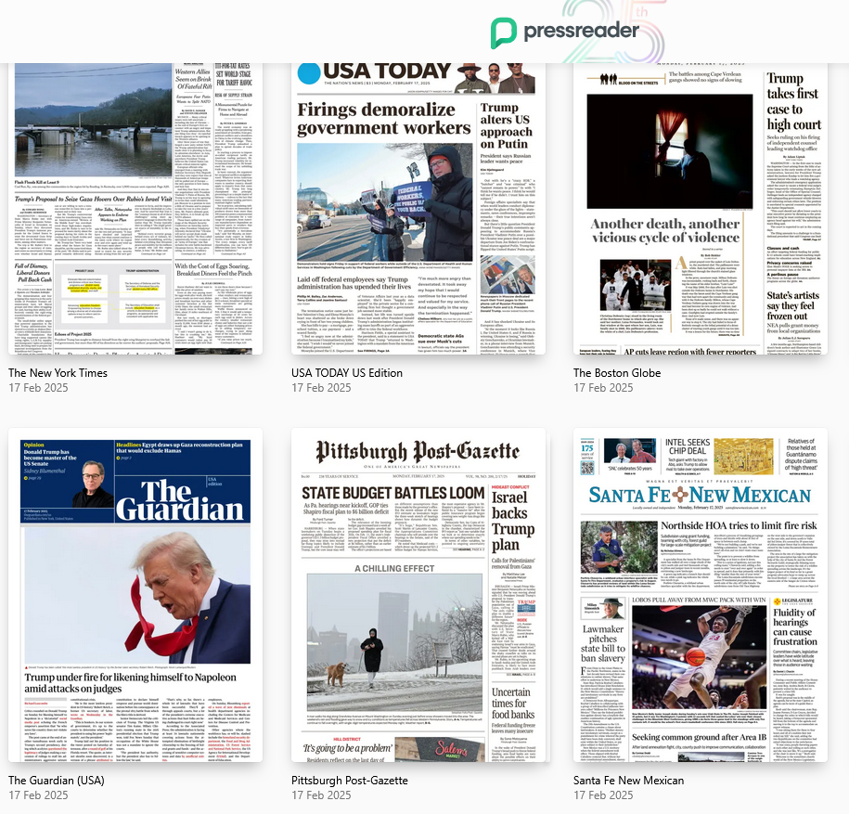
Round 1: The Onion article or real?

Slide 18
Question 1
Report: High Turnout Traced To Americans Mistakenly Voting On Vending Machine

Slide 19
Question 2
Campaign launched to make public toilets a legal requirement in Britain

Slide 20
Question 3
Japanese woman arrested for squashing bun in shop

Slide 21
Question 4
DeSantis Threatens To Cut Hospital Funding If Surgeons Keep Wearing Masks

Slide 22
Question 5
Igloo recalls coolers over finger amputations and injuries

Slide 23
Round 2: AI or Not?
Shamelessly borrowed from CNET.com
Notes:
https://www.cnet.com/pictures/ai-or-not-ai-can-you-spot-the-real-photos/

Slide 30
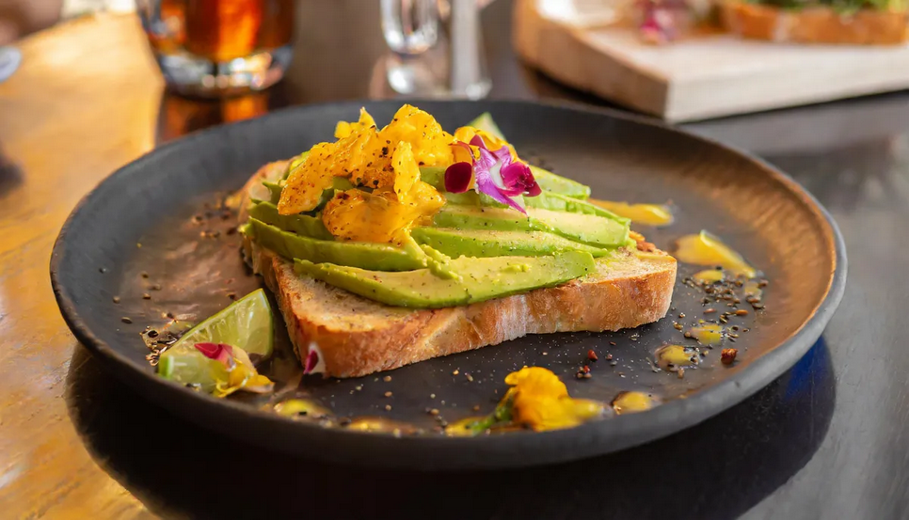

Slide 32
Round 3: What’s the Missing Word?

Slide 33
Question 1:
Visitors flock to New York botanic garden for a whiff of a flower that smells like a __________

Slide 34
Question 2:
104-year-old woman celebrates birthday by ____________

Slide 35
Question 3:
Nationwide power outage in Sri Lanka blamed on __________

Slide 36
Question 4:
Cascades of ______ flood a city's streets in Portugal after huge tanks rupture

Slide 37
Question 5:
A service dog gets his own ________, winning huge cheers

