Slide 1
Louisiana Balance of State Continuum of Care
Connecting Library Patrons with the homeless services system
Victoria Johnson, Coordinated Entry Specialist Carrie Patterson, LCSW, CoC Manager

Slide 2
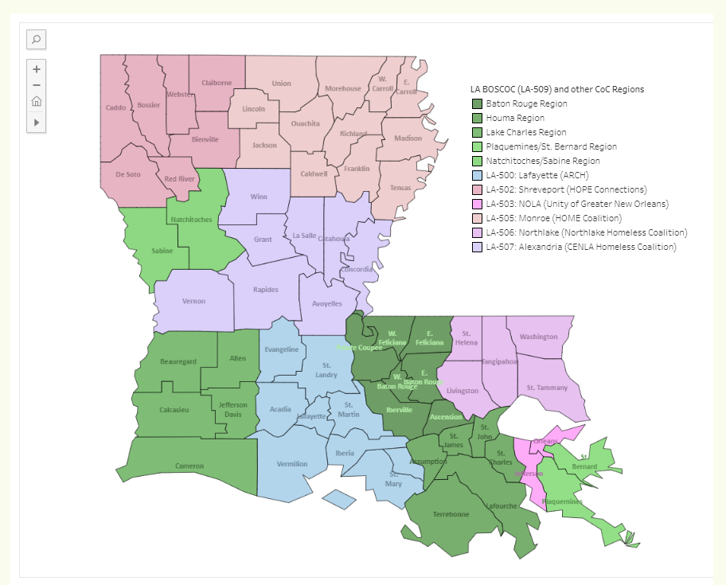
LA BOSCOC
The Louisiana Balance of State Continuum of Care (LA BOSCOC)
Coalition of people and housing service providers dedicated to preventing and ending homelessness
Louisiana Housing Corporation is the LA BOSCOC lead agency
Geography: Lake Charles area, Baton Rouge area, Natchitoches/Sabine, Plaquemines/St. Bernard and Houma area (22 parishes)
What is a Continuum of Care or CoC?
US Dept of Housing and Urban Development (HUD) mandates that all communities across the country be served by a CoC.
CoCs serve as the federally recognized homeless coalitions that serve a certain geography.
There are 381 CoCs in the country and 7 CoCs in Louisiana.

Slide 3
2024
410
Individual people counted
2023
435
Individual people counted
PIT Data
2022
526
Individual people counted (776 if Ida Disaster shelter included)
Point in Time (PIT) Count Data for the LA BOSCOC Baton Rouge Region
(EBR, WBR, East Feliciana, West Feliciana, Ascension, Iberville, Pointe Coupee)
2021
Pandemic Year
No unsheltered PIT count conducted
2020
430
Individual people counted
Notes:
Baton Rouge has the largest concentration of CoC Program funded housing providers in the LA BOSCOC and will receive roughly $8 million (out of $29 million) in CoC Program funding in FY23.

Slide 4
Who do CoCs serve?
HUD Categories of Homelessness:
Category 1 - Literally Homeless: This includes individuals or families who:
Are sleeping in an emergency shelter or in a place not meant for human habitation, such as on the streets, in vehicles, or in abandoned buildings.
Category 2 - Imminent Risk of Homelessness: This category includes individuals or families who:
Are facing eviction within 14 days and have no subsequent residence identified.
Category 4 - Fleeing Domestic Violence:
• Any individual or family who:
Is experiencing trauma or a lack of safety related to, or fleeing or attempting to flee, domestic violence, dating violence, sexual assault, stalking, or other dangerous, traumatic, or life-threatening conditions related to the violence against the individual or a family member in the individual's or family's current housing situation, including where the health and safety of children are jeopardized
• Has no other safe residence, and
• Lacks the resources to obtain other safe permanent housing

Slide 5
All CoCs have a Coordinated Entry System
Four core elements:
Assessment
Access
All CoCs are required to use a standardized assessment tool in determining the vulnerability of a household being served by Coordinated Entry. In Coordinated Entry, the people who need help most urgently, like those who are severely disabled or are in danger, are identified through this assessment process.
Access is about making it easy for people to get connected to resources they need to return to stable housing. Just like when you need to find your way into a building, you need doors that are open and signs that show you where to go. Coordinated Entry is meant to be these "doors" and "signs" so anyone who needs help finding resources and/or other support can find it. There are “Access Points” across the state of Louisiana
Prioritization
& Referral
Diversion
Diversion is finding a different solution to a housing crisis. Sometimes, instead of going straight to a shelter or getting a housing voucher, Coordinated Entry can help people think of different solutions that might work better for them.
After assessment there is prioritization. People who are prioritized for housing are eligible to receive COC housing vouchers (to RRH, PSH, TH). When a housing provider has a unit available, Coordinated Entry assigns an appropriate person to the voucher.
Notes:
Access Points:
Throughout our catchment area we have access points. They are a critical element of our COC, and provide the implementation of Coordinated Entry. Access points can provide the following services:
Initial contact with people experiencing homelessness
Direct them to emergency services
Assist them in returning to housing using their own support networks,
Triage them for housing and supportive services

Slide 6
Coordinated Entry, Cont.
Because the LA BOSCOC’s homeless population significantly exceeds its resources, the CES uses two strategies to ensure each person is served according to their needs
1. Resiliency-Based Engagement: CES attempts to serve each person with the ‘lightest touch’ intervention before escalating to more intensive interventions;
2. Needs-based Triage: LA BOSCOC uses the Participant Triage Tool (PTT) to triage people for housing and services, prioritizing those with the greatest needs first.

Slide 7
What to Expect from Coordinated Entry
Lottery Analogy - Coordinated Entry is not a guarantee of Housing, but it is the only way to access some federally funded housing assistance resources.
Rapid Exit Case management period and Prioritization- 30 days between initial access and assessment
Prioritization and referrals - The Prioritization list is dynamic, referrals are driven by the availability of housing project resources

Slide 8
Connecting Patrons experiencing Homelessness to Coordinated Entry:
www.LABOSCOC.org/housing-intro
Head over to our website: https://laboscoc.org/housing-and-services
and click on the map to identify Coordinated Entry Access Points for a specific area.
Understand your CoC’s Coordinated Entry System so that you can support households in navigating their local homeless services system.

Slide 9
Connecting Patrons experiencing Homelessness to Coordinated Entry:
Head over to our website: www.laboscoc.org/outreach
and submit a portal Request for outreach
Outreach Request are responded to by Outreach teams across our catchment area

Slide 10
Other Resources
McKinney Vento: “Students in Transition” or homelessness liaisons are designated in each school district: https://sites.google.com/ebrschools.org/parent-university/students-in-transition
Salvation Army: https://www.salvationarmybatonrouge.org/
Prison Reentry
Joseph Homes: https://www.ccdiobr.org/what-we-do/transitional-housing/joseph-homes/
One Touch Ministry: https://www.1touchministry.org/
Sanctuary for Life: https://www.ccdiobr.org/what-we-do/transitional-housing/sanctuary-for-life-housing/
Notes:
Salvation Army provides shelter for people experiencing homelessness. Shelter is free for the first 7-10 days, but there is an associated fee after that.
Joseph Homes and One Touch Ministry provide transitional housing for people exiting incarceration or that have recently exited incarceration.
Sanctuary for Life offers emergency for women 18 and older that are pregnant and up to 6 months after giving birth.

Slide 11
Brief Engagement and De-escalation Tips
Engagement
Treat someone you believe might be experiencing homelessness the same as you would any other patron.
Follow the lead of the patron!
De-escalation
Take a deep breath
Focus on nonverbal communication
Be empathetic
Provide information as able - but be realistic
Notes:
Greet them like you would any other library patron. Make eye contact. Say"Hello, let me know if you need any help, etc."
Respect personal space! People experiencing homelessness may lack any location where they can feel truly safe. With that in mind, personal space becomes even more important. Avoid cornering someone.
Follow the lead of the patron. If someone isn’t interested in talking, let them be.
It might take someone a while to feel comfortable to ask for resources. If someone repeatedly comes to your branch, keep using those basic engagement strategies - eye contact and a friendly greeting. Someone might ask you for resources the first time they come in, they might ask on one hundred and first time.
Take a deep breath. The hardest part of helping someone in crisis is often keeping yourself calm. The better you’re able to do this, the better you’ll be able to handle the situation.
The more distressed someone is, the less they hear your words. This means that nonverbal communication is important. Again, respect personal space. Be mindful of your gestures, facial expression, movements, and tone of voice.
Be empathetic. It is harder to be angry with someone who is empathizing and agreeing with you. This is not to say you can’t set clear boundaries, but only that you should empathize with their feelings in that moment.

Slide 12
THANK YOU
Carrie Patterson, LCSW
COC Manager
(225) 763-8903
cpatterson@lhc.la.gov
Victoria Johnson
Coordinated Entry Specialist
(225) 763-3986
vjohnson@lhc.la.gov
www.LABOSCOC.org

